Slide 1
Software group project
Automated Fuel Level Indicator
Id Of Students :1.)20IT113-Shiv Patel
2.)20IT107-Prince Patel
Counsellor : Parth Shah

Slide 2
What Is Fuel Level Indicator?
Fuel-management systems are used to maintain and monitor fuel consumption and remaining stock in fuel tank or storage.
This system can use by any type of industry that uses transporation.

Slide 3
Fuel monitoring systems are designed to effectively measure and manage the use of fuel within the transporation and construction industries.
They are typically used for vehicles that require fuel to operate.

Slide 4
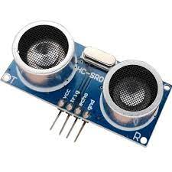
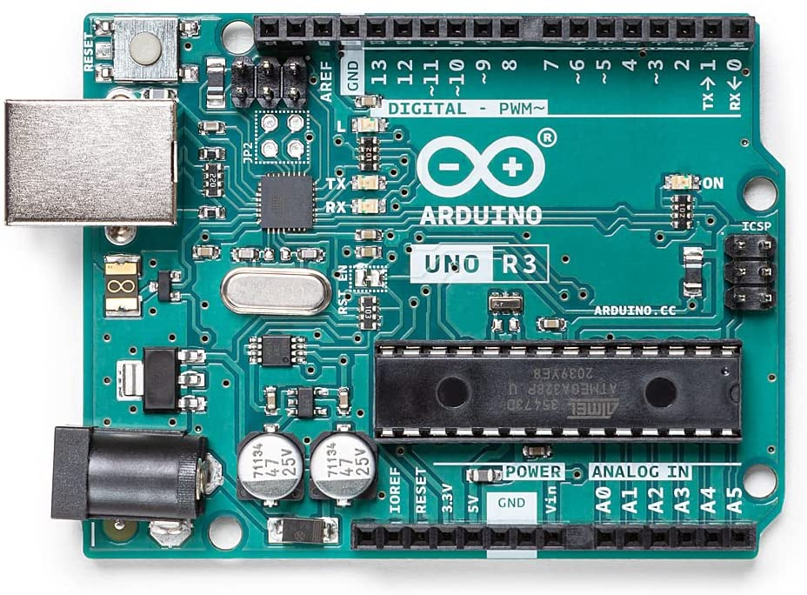
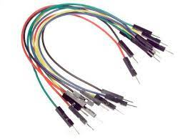
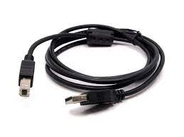
Hardware:
Ardunio Uno
Ultrasonic Fuel Sensor

Slide 5
Ardunio Uno:
Arduino/Genuino Uno is a microcontroller board based on the ATmega328P . It has 14 digital input/output pins (of which 6 can be used as PWM outputs), 6 analog inputs, a 16 MHz quartz crystal, a USB connection, a power jack, an ICSP header and a reset button. It contains everything needed to support the microcontroller; simply connect it to a computer with a USB cable or power it with a AC-to-DC adapter or battery to get started.
Ultrasonic Fuel Sensor:
All elobau ultrasonic fuel level sensor models provide continuous, contactless measurement, making them ideal for measuring fluids found in machine tools, like oil or hydraulic fluid, that cannot be tainted by the introduction of foreign materials.

Slide 6
ABOUT PROJECT:
We are switching to an ultrasonic sensor now as it can be placed a distance away from the water and the fear of it getting corroded is removed. The ultrasonic sensor is not waterproof though, so we will need to keep it protected. We connect the sensor to an Arduino, and as per the changing water level new signal readings would be sent letting us know the level.
The ultrasonic sensor works similar to how a SONAR works. It sends out a pulse of ultrasonic waves, these waves are reflected back when it hits an obstacle.
The time it takes for the reflected waves to return is used to calculate the distance.

Slide 7
Objective of this work: The objective is to design digital fuel level and battery life indicator which would the following:-
1. Selecting appropriate automotive application (motor bike/car)for carrying out this study to indicate fuel level and battery health.
2. To design the circuit diagram and make correct connection of each electrical component by using classical approach design available in literature.
3. To make the program using Arduino IDE software of both fuel and battery level
4. Because of flat bottom section of fuel tank and using single ultrasonic sensor at top of fuel tank there is less chances of error in running of programming.
5. To check accuracy of output result by practically measuring the quantity of fuel by pouring and removing from tank.

Slide 8
REQUIRED THINGS:
Arduino Uno
HCSR04 Ultrasonic sensor
LEDS which are used to display the level of water
Connecting wires
Bread board

Slide 9
Conclusion:
The proposed idea consists of ultrasonic technique for fuel Level that acquires the measured fuel level and sends to the display unit which is present on the dash board. The data acquired from the sensor is given to the microcontroller. At the same time Ultrasonic sensor which is connected and arduino uno microcontroller gives we reading on display through LED glowing.

Slide 10
Thank You

